Slide 1



TEAM AICHEMISTS
Advanced Business Analytics on World Bank Global Financial Inclusion (Findex) Data
Bridging the Gaps in Financial Inclusion: Understanding
the Cash-Credit Paradox,
Divide between Cash and
Digital Payments, and
Financial Resilience
Dataset: (World Bank Global Financial Inclusion (Findex) Dataset 2021)

Slide 2

Problem Statement
Many individuals with bank accounts still prefer cash transactions due to distrust in formal financial institutions, low financial literacy, and economic challenges. This reliance on cash creates a "cash credit paradox," where those who are financially included face barriers in accessing formal loans, often resorting to informal borrowing. Additionally, the “digital divide” complicates access to digital financial services, highlighting the need for solutions that enhance “financial resilience” and security.
Cash Credit Paradox - Financially included individuals still rely on informal borrowing due to loan access barriers.
Digital Divide - Limited skills and resources hinder the shift from cash to digital payments.
Financial Resilience - Building trust, literacy, and access to strengthen financial stability.

Slide 3

Methodology
Data Preprocessing and
Cleaning
Exploratory Data Analysis (EDA) and Data Visualizations
Data
Modeling using Random Forest Classifier
Advanced Data Analytics using PowerBI
www.reallygreatsite.com

Slide 4
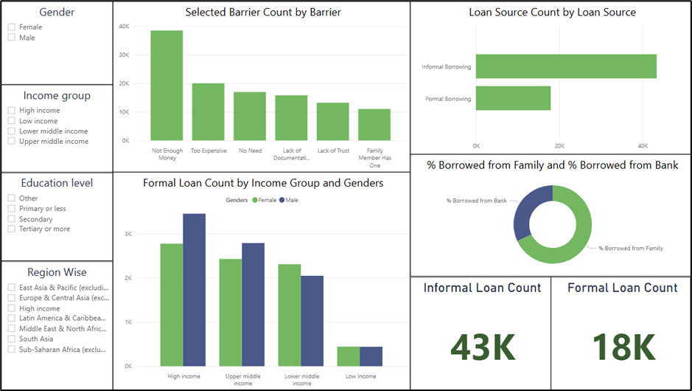
Key Insights
1. Cash-Credit Paradox

Slide 5
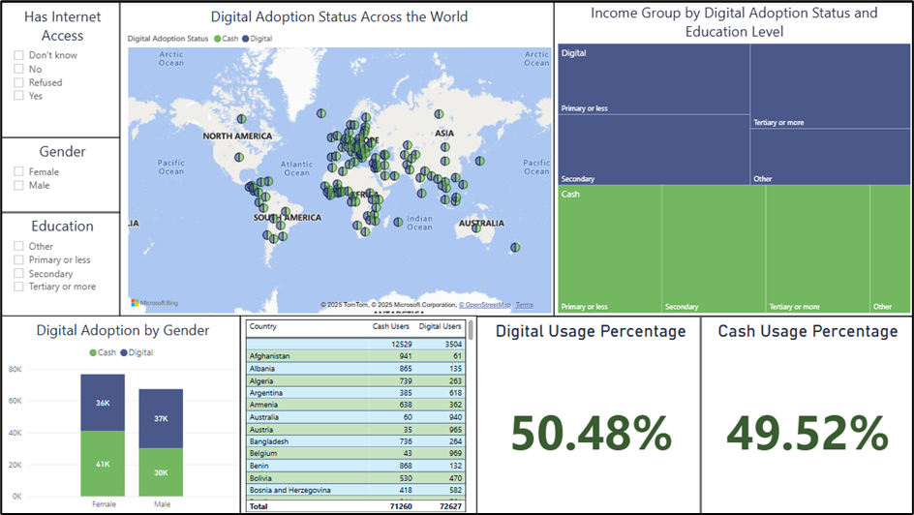
Key Insights
2. Digital vs. Cash Divide

Slide 6
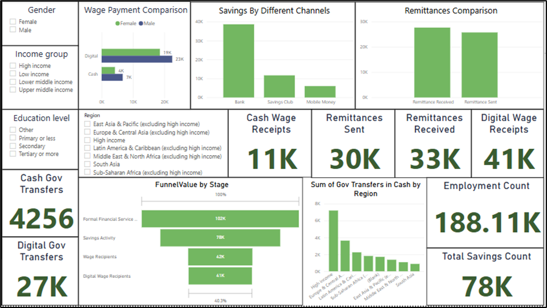
Key Insights
3. Financial Resilience and Security

Slide 7

Summary of Findings
73.2% of financially included individuals still rely on cash, despite 64.9% using digital payments at least once. This shows a strong cash dependence.
Cash vs. Digital Banking Adoption
Lack of trust (reported by 38.7%), low financial literacy (42.5% of respondents with only primary education), and economic constraints (52.1% of the lowest-income group) are major reasons for avoiding digital payments.
Digital payment adoption is highest among higher-income individuals (89.4%), males (68.2%), and urban regions (74.6%), while rural areas lag behind at 58.3%.

Slide 8
Summary of Findings
While 70.9% have a bank account, only 24.3% have taken a formal loan, proving that account ownership does not directly lead to better credit access.
The Credit Access Illusion
56.7% of borrowers prefer informal lending from friends and family due to easier access and no strict eligibility criteria, whereas only 15.2% get bank loans.
Key barriers include high-interest rates (47.6% cited this issue), lack of collateral (39.8%), and documentation issues (28.4%).

Slide 9
Summary of Findings
People with savings accounts (68.9%) are 3.2 times less likely to depend on cash or informal borrowing, reducing financial vulnerability.
Financial Security & Economic Resilience
Government transfers (received by 31.5%) and remittances (received by 23.8%) significantly boost financial stability, with 78.4% of transfer recipients having a bank account.
Those receiving digital wages (41.2% of employed individuals) are 2.7 times more likely to use formal financial services like savings and insurance.

Slide 10

Recommendations/Solutions to Users
Enhance Financial Literacy
1
Utilize Digital Financial Services
2
Build a Strong Credit Profile
3
Engage with Financial Institutions
4
Focus on Savings & Financial Resilience
5

Slide 11
Scalability
Global Reach
Durability
Target Audience
Global Findex data covers 123 economies.
Cash preference, credit barriers, & digital divides exist globally.
Findings applicable worldwide with regional adjustments.
Relevant over time, despite using 2021 data.
Core issues persist as financial services evolve.
Future research can track progress with updated data.
Scalable to diverse populations.
Considers income, gender, location.
Expand to include education, employment, age, etc.

Slide 12



Thank You!

